Slide 1
Decentralized Cooperative Conflict Resolution for Multiple Nonholonomic Vehicles
Frazzoli, Pallottino, Scordio, & Bichi 2005

Slide 2
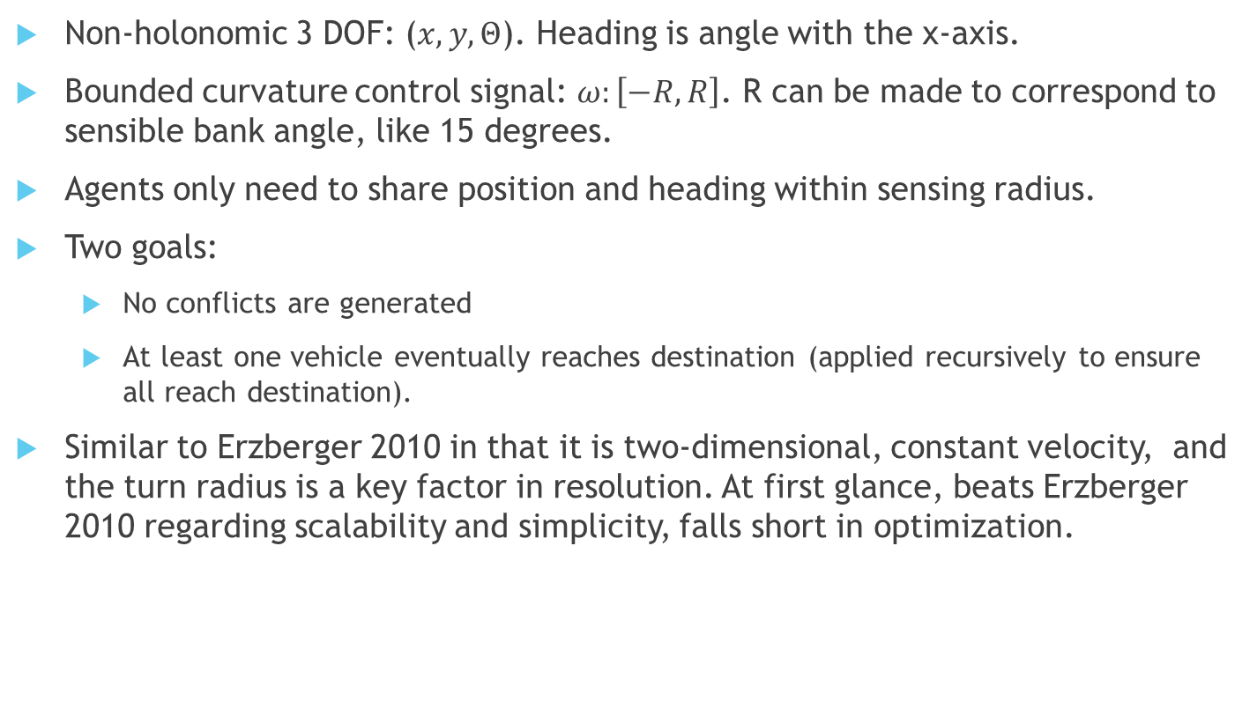
Formulation
Non-holonomic 3 DOF: ($x,y,Θ$). Heading is angle with the x-axis.
Bounded curvature control signal: $ω:\left[−R,R\right]$. R can be made to correspond to sensible bank angle, like 15 degrees.
Agents only need to share position and heading within sensing radius.
Two goals:
No conflicts are generated
At least one vehicle eventually reaches destination (applied recursively to ensure all reach destination).
Similar to Erzberger 2010 in that it is two-dimensional, constant velocity, and the turn radius is a key factor in resolution. At first glance, beats Erzberger 2010 regarding scalability and simplicity, falls short in optimization.

Slide 3
Coordination Policy

Slide 4

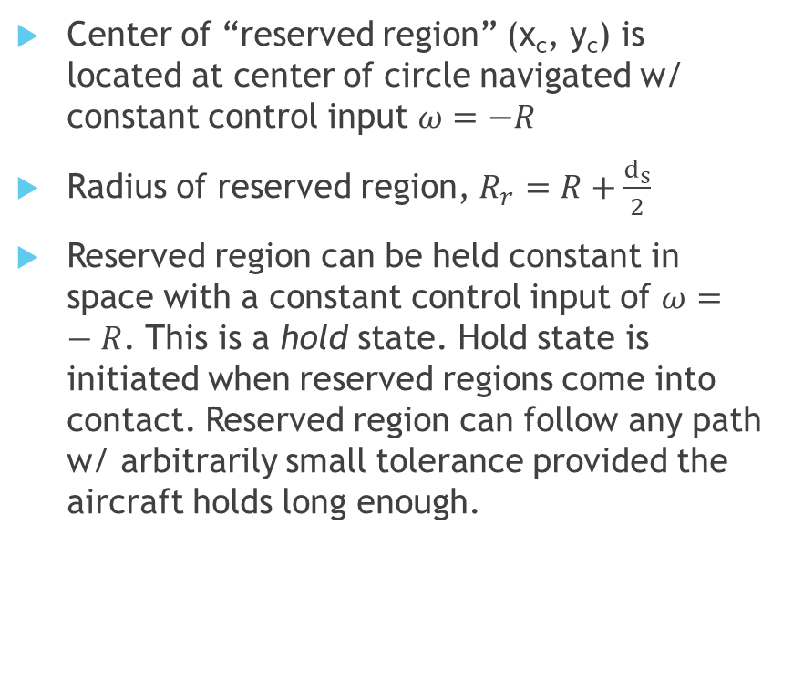

Reserved Region
Center of “reserved region” (x_{c}, y_{c}) is located at center of circle navigated w/ constant control input $ω=−R$
Radius of reserved region, $R_{r}=R+\frac{d_{s}}{2}$
Reserved region can be held constant in space with a constant control input of $ω=−R$. This is a hold state. Hold state is initiated when reserved regions come into contact. Reserved region can follow any path w/ arbitrarily small tolerance provided the aircraft holds long enough.
R
$$\frac{d_{s}}{2}$$

Slide 5
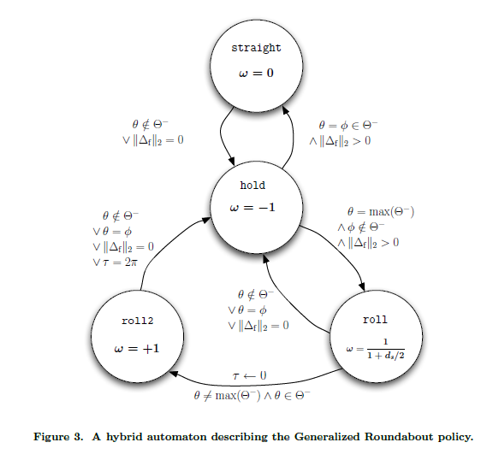
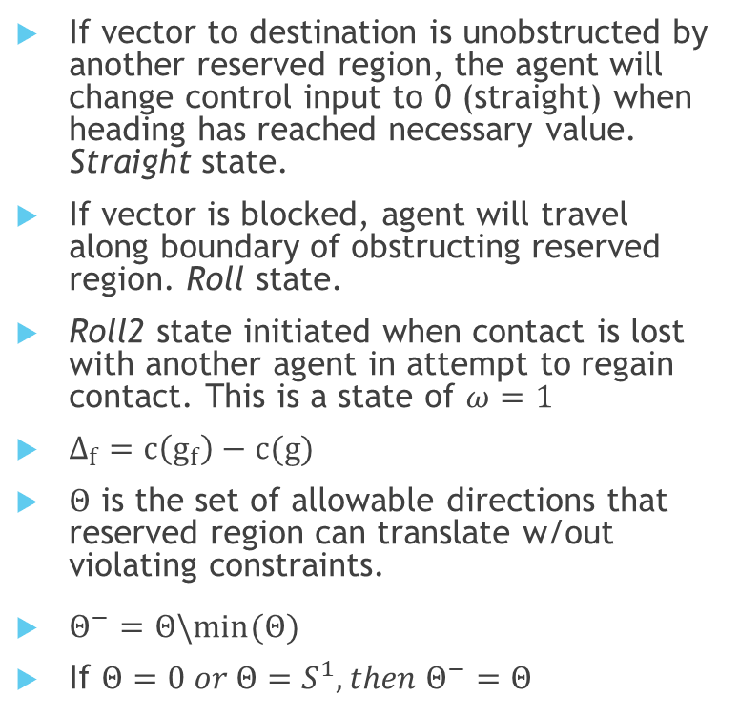
Generalized Roundabout Policy
If vector to destination is unobstructed by another reserved region, the agent will change control input to 0 (straight) when heading has reached necessary value. Straight state.
If vector is blocked, agent will travel along boundary of obstructing reserved region. Roll state.
Roll2 state initiated when contact is lost with another agent in attempt to regain contact. This is a state of $ω=1$
$Δ_{f}=c\left(g_{f}\right)−c(g)$
$Θ$ is the set of allowable directions that reserved region can translate w/out violating constraints.
$Θ^{−}=Θ\backslash min(Θ)$
If $Θ=0 or Θ=S^{1}, then Θ^{−}=Θ$
pp. 7 Frazzoli et. al (2005)

Slide 6
Considerations/Implementation
Implementation will likely be easier in Simulink, as communication conditions and internal variables are clear.
Lends itself well to the real time nature of Simulink, as this algorithm is more reactionary.
As of the year this paper was published, the ‘liveness’ of the algorithm could not be proven. Therefore, there is no solid metric on how quickly agents will resolve conflicts nor how delayed they will be.
Holding requires a constant control input and radial acceleration. In passenger situations with higher bank angles like 30 degrees (likely required in more congested airspace), this could prove uncomfortable as 1.155 g’s are experienced.

